Slide 1
Tech Tips - Using Colour Scales in Tables in IBM SPSS Statistics

Slide 2
Tech Tips - Using Colour Scales in Tables in IBM SPSS Statistics

Slide 3
Tech Tips - Using Colour Scales in Tables
Did you know that there is an easy way to apply colour scales to your tables?
Color Scales is a new feature in IBM SPSS Statistics Version 28.
For example, we want to highlight increased missed payments.

Slide 4
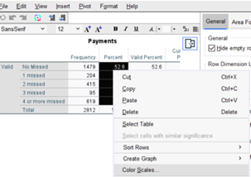
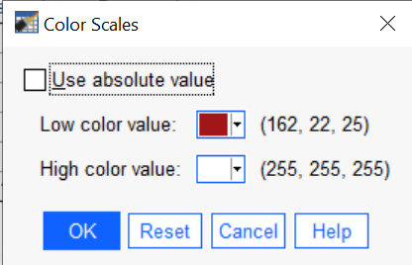
Tech Tips - Using Colour Scales in Tables
To apply Color Scales, run a table. In the Output, double click on the table to open it.
Select values to color. In this case it is the Percent column. Right click on the selection, select Color Scales, and select color values. Click OK.

Slide 5
Tech Tips - Using Colour Scales in Tables
The final table is shown below. It’s that easy!

Slide 6
SPSS Tech Tips
For more Tech Tips, go to the Tech Tips section within the Learning Hub.
Contact us
SPSSAdmin@version1.com
+ 44 (0) 203 859 4790
+ 353 (0) 1 865 7800
www.spssanalyticspartner.com

